Slide 1


Worldwide coffee production
Presented by Saba

Slide 2
INTRODUCTION
Coffee is an hot drink made from the roasted and ground seeds(coffee beans) of a tropical shrub.
The four main coffee types are Arabica, Robusta, Excelsa and Liberica .
Out of them Arabica & Robusta is the most popular worldwide hence we will find here how many countries are involved
In production of these coffee seeds.
Arabica beans : an evergreen shrub or tree yielding seeds that produce a high quality coffee and form a large portion of the coffee of commerce.
The seeds of arabica especially roasted and often ground.
Robusta : a coffee that is indigenous to central Africa but grown in Java and has high resistance to coffee rust. The seeds of Robusta is known for high caffeine.

Slide 3
Agenda
We will do a small case study by taking 55 Countries into consideration to better understand the production of coffee beans from 2010-2020.
Researches needs to be done on:
Which coffee is produced at large scale?
Which coffee is produced at small scale?
Country wise coffee production ?
Top 5 Countries to involve on high production of Arabica?
Top 5 Countries to involve on high production of Robusta?
Production Report from 2010-2020 on yearly basis?
Country with no production?
How many percentage of countries producing Robusta?
Highest production year?
2019-2020 production count of Arabica & Robusta?

Slide 4
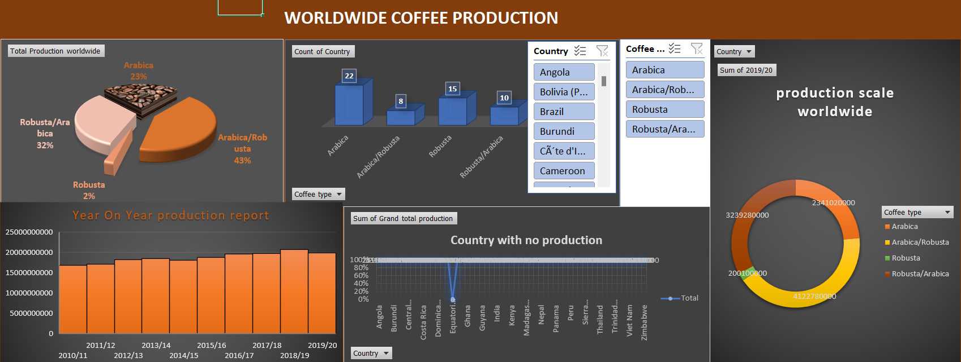

Slide 5
Based on the Research we found that:
--- Arabica seeds are produced on large scale from 2010 to 2020.
--- Over these 10 yrs Robusta was only produced by 2% of an entire production.
--- Out of 55 countries we found that 22 countries are involve into production of Arabica seeds, where 15 countries are majorly focusing on production of Robusta, 18 other countries are involved in production of both the coffees.
--- Top 5 countries are involved in production of Arabica is Nicaragua, Colombia, Ethiopia, Honduras & Peru.
--- Top 5 countries are involved in production of Robusta is CÃ´te d'Ivoire, Lao People's Democratic Republic, Madagascar, Guinea & Togo.
--- Production Report from 2010-2020 (Refer 4rth slide , year on year production report chart)
--- Equatorial Guinea is the only country who is not involved in production .
--- Out of 55 countries only 15 countries are producing Robusta in percentage 8.25% .
--- 2018-19 was the highest production year with count of 10347780000 .
--- 2019-20 production count of Arabica is 2341020000 and Robusta count is 200100000.

Slide 6
Data Reference :
https://www.kaggle.com/datasets
Insights:
We have used Pivot table to summarize large amount of data quickly by grouping and aggregating it.
Also have used pie charts, doughnut chart, Histogram chart, stacked line chart & Column cluster charts to make a presentable data with Slicer on it.

Slide 7


